Slide 1
HealthCare Analytics- Group 2
MR.Sathiyababu Chellappan
MR.PramodKumar
Miss.Bhagyashri Vinit Dumbre
Mr.Malladi Venkatesh
Miss.Sakshi Mishra
Mr.Sairam Balapurkar

Slide 2
Introduction
Objective: To Create Healthcare Analysis Dashboard & stories.
Scope: Perform Analysis from healthcare data using Tableau and Power Bi.
The Health Care Data Designed to meet the health needs of community through hospital and community health Agencies.

Slide 3
Understanding Data
The data consists of 10,48,576 rows and 73 columns.
The common ID to track each data by using NPI(National Provider Identifier) Number.
The Medical Service mostly Provided in united states country.
There are totally 109 Provider type available in the data across USA like Cardiology, Nurse Practitioners, Emergency Medicine etc..
Total Medical Beneficiaries taking Services in all cities like New York, Houston etc.,
Service Provided to people by all different Credential members involved in the data like M.D., PH.D,D.O etc..,
Data consists of Number of Medicare Beneficiaries With Medical Services and Drug Services.
Data contains Information about Total Drug Submitted Charges and Drug Medicare Payment & Disease wise Beneficiaries.

Slide 4
KPI(Key Performance Indicator)
Total Providers
Designation Wise Providers Count
City Wise Providers
Type of Provider Count
Total no of service
Total charge Amount by providers
Total Drug Submitted Charge Amount
Number of Medicare Beneficiaries

Slide 5
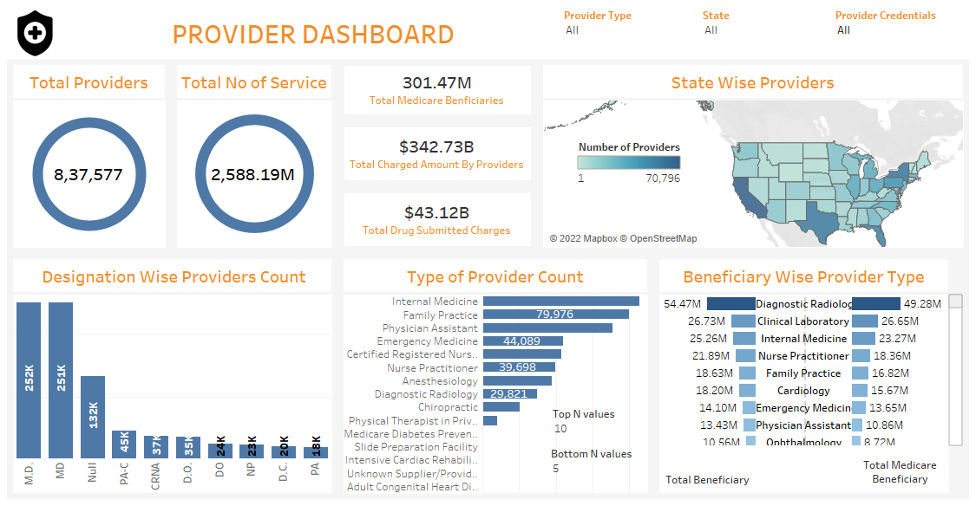
Tableau Dashboard

Slide 6
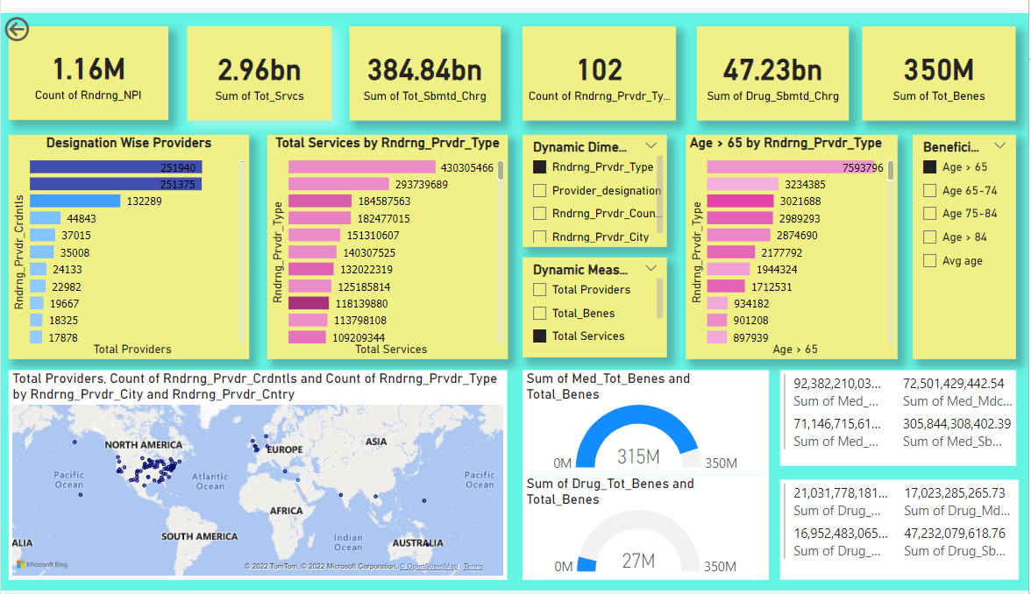
Power BI Dashboard

Slide 7
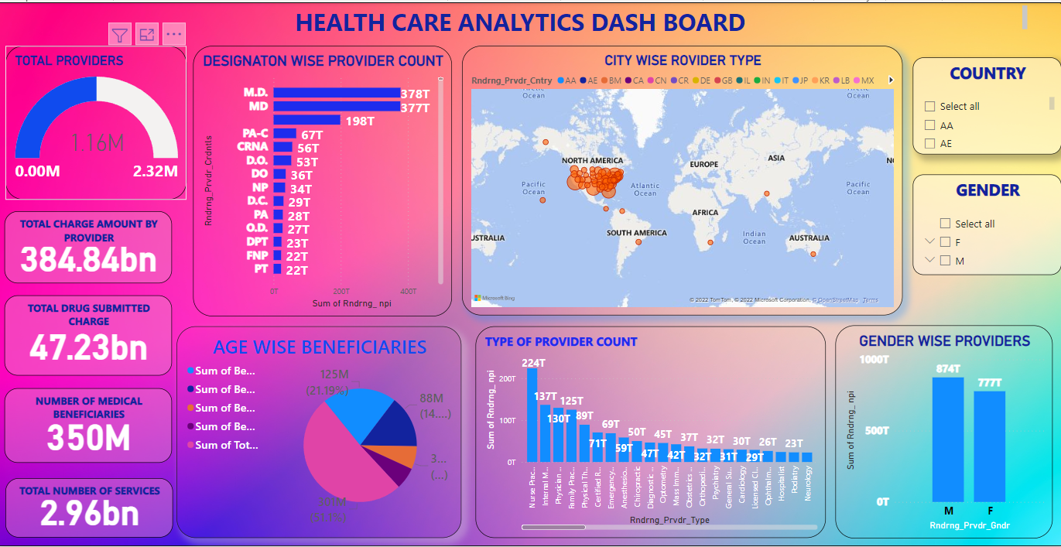
Power bi Dashboard

Slide 8
Story of Project
Insights
43% of Medicare Beneficiaries coming under age group between 65 to 74.
Providers in Northern Part of America is less than other part of America.
Out of 350 M beneficiary, 315M beneficiary taking advantage of Medicare services and only 27 M taking drug services.
503k Doctor of Medicine (M.D) Provided maximum services to the people.
Provider type Nurse practitioner, provider credential MD, provider country USA, provider city New York having maximum number of providers.
Top 5 Provider type: Internal Medicine, Family Practice, Physician, Nurse Practitioner and Physical therapy in private Practice .
Top 5 Provider city: New York, Houston, Chicago, Philadelphia and Boston.
Top 5 Beneficiary Cities: Houston, New York, Baltimore, Chicago, Burlington

Slide 9
Conclusion
Implemented Tools to Convert data into Useful graphical form of output by generating Dashboards in both Tableau and Power BI.

Slide 10
Thank You

